Slide 1



GIT-HUB AS A COLLABORATION TOOL
For
Digital Technologies
9/10IST
11/12 Software Design and Development
David Hawkes
twitter.com/frnddavid
www.linkedin.com/in/dhawkes/

Slide 2
So what’s Git???
Git is a version control system (VCS) for building software
Linus Torvalds, creator of Linux OS, developed it in 2005 for Linux kernel development.
Open source
Used by small and large teams giants like Google, Red Hat, and IBM
Distributed revision control system for software
Think of it as an cloud based code swapping service
Made for collaboration

Slide 3
BUSINESS CASE
21 Century Employability Skills
Collaborative Problem Solving
Free source code access
Software Developers love to share their code

Slide 4
Benefits to Students
First port of call for ideas on solutions
Classified by programming language
Searchable by problem to be solved
Students can create their own software storage repositories(repos)
Software can be forked from other repos to their own repo
Students need to acknowledge the source of their code to avoid plagiarism

Slide 5
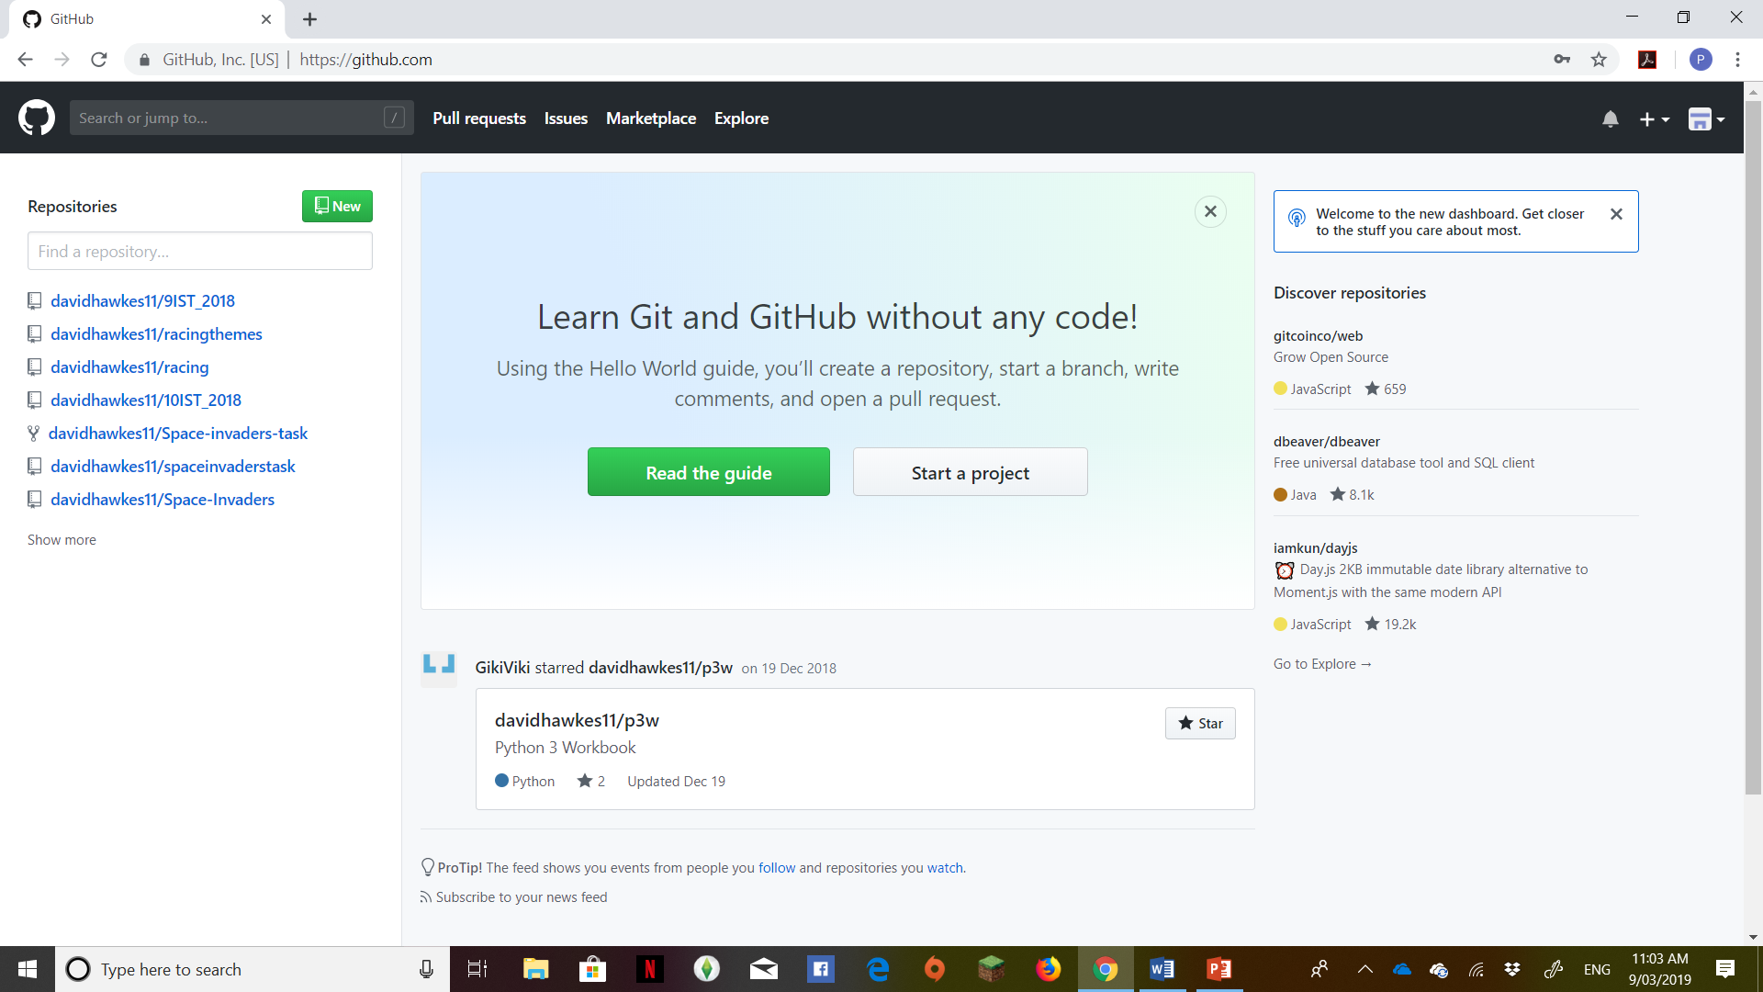
Starting out with Github

Slide 6
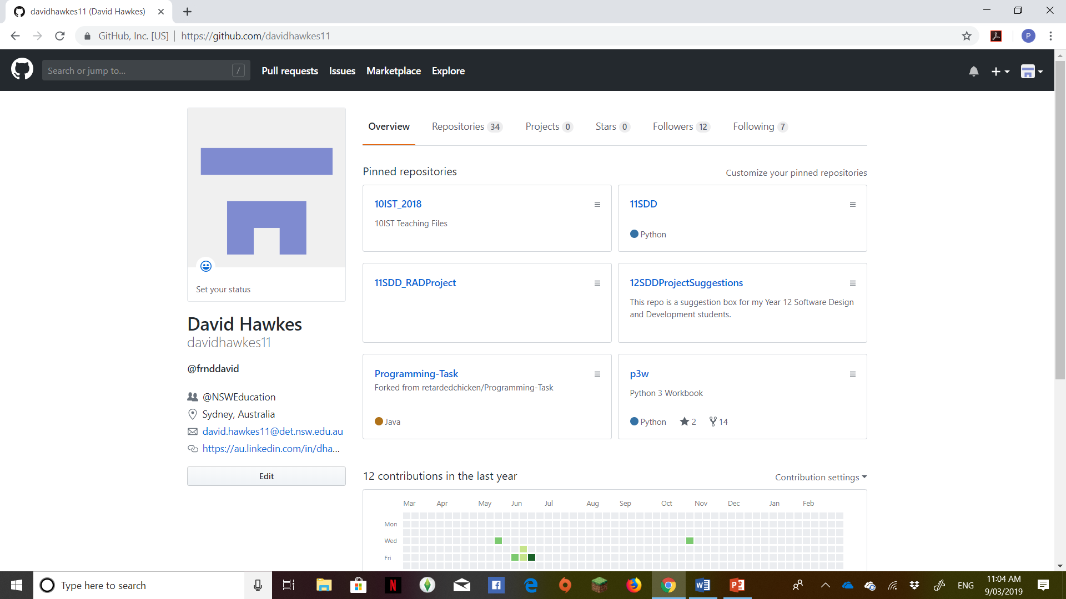
My Repo

Slide 7
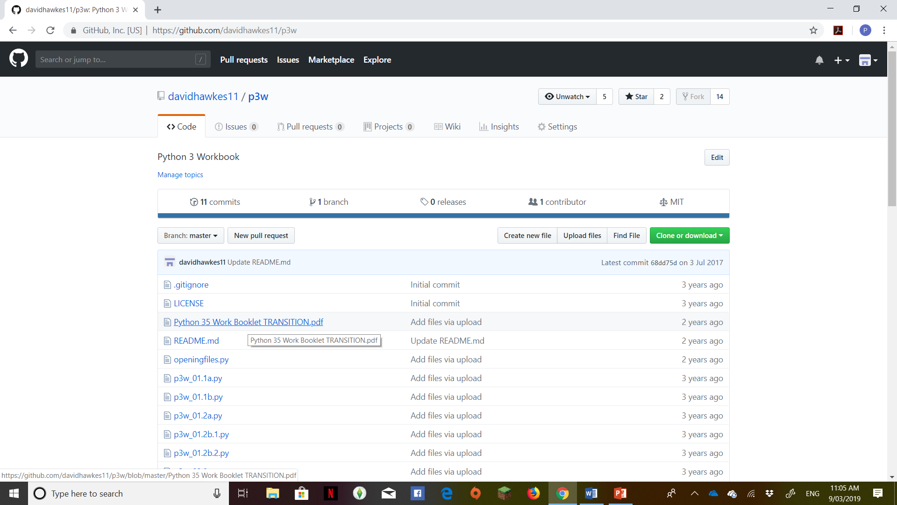
Python 3 Work Book

Slide 8
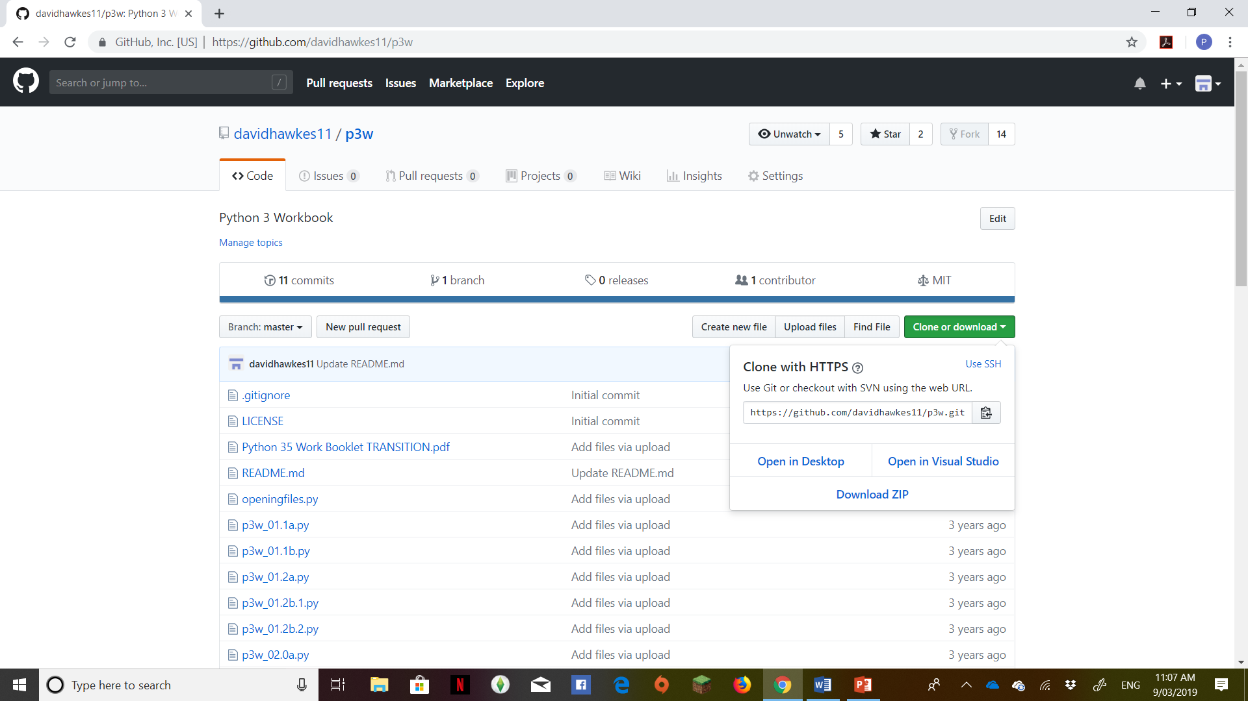

Slide 9
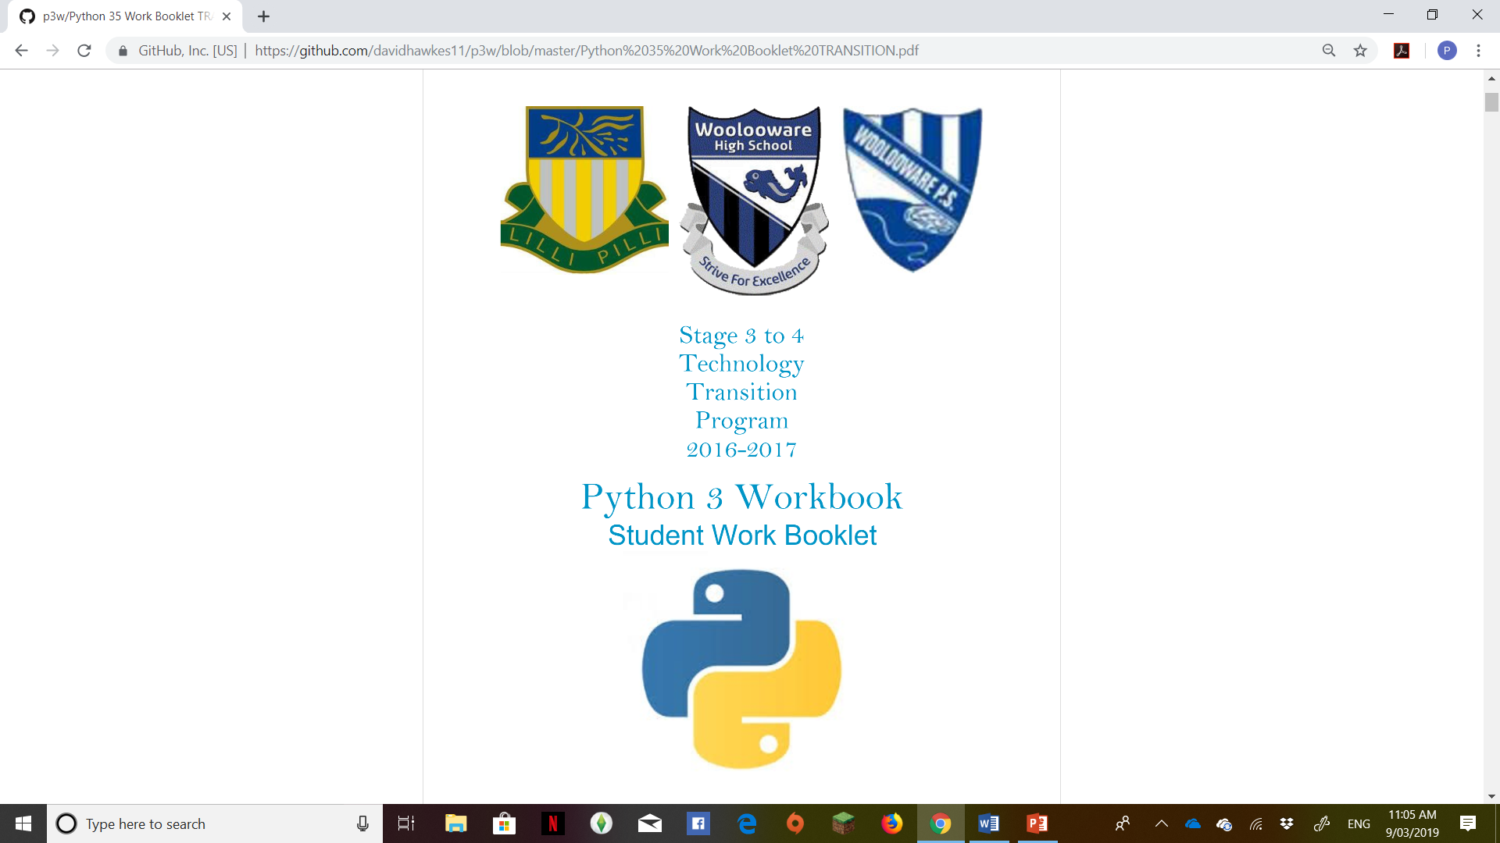

Slide 10
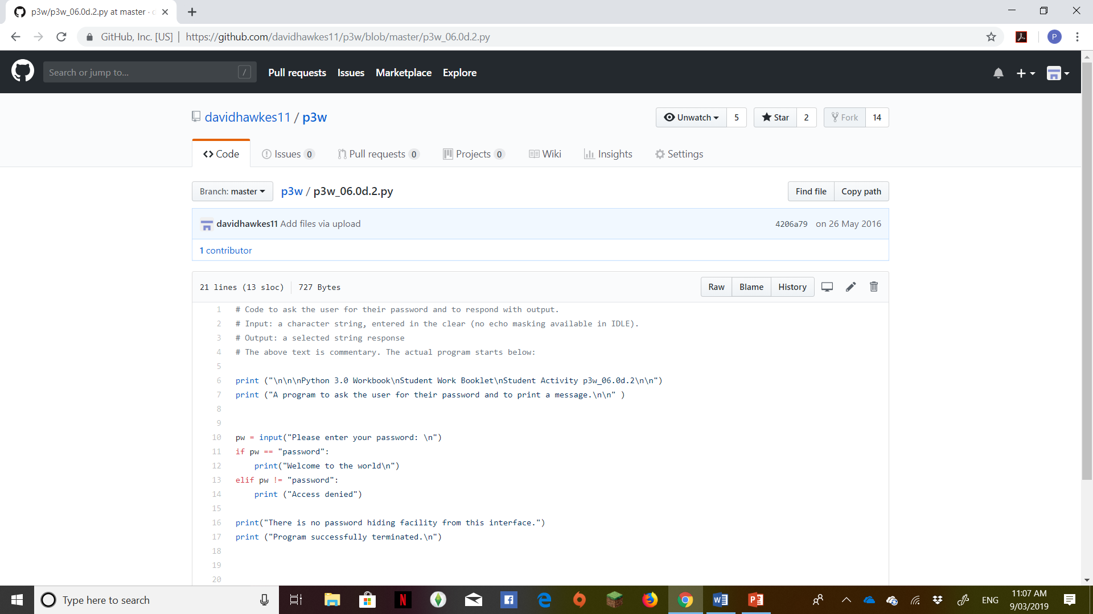

Slide 11
Cool things you can do with Github
https://hackernoon.com/12-cool-things-you-can-do-with-github-f3e0424cf2f0
#1 Edit code on GitHub.com
#2 Pasting images
#3 Formatting code
#4 Forking code from other repos
#5 Linking to comments
#6 Linking to code
#7 Using the GitHub URL like the command line
#8 Project boards in GitHub
#9 GitHub wiki
#10 Using GitHub as a CMS

Slide 12
Github in the Classroom
You can use it to share code with your students
They can fork it from your repo
They can download it from your repo
They can upload their source code to your repo
Source code is available in raw format

Slide 13
